Slide 1

‘Artificial intelligence and data science methods for analyzing academic performance in higher education’
Hosted by:
Bruno Silva
Diogo Silva

Slide 2
WORKSHOP ROADMAP
Theory
Python Implementation
Doubts clarification

Slide 3
Theory
Random Forests
Neural Networks
Data PreProcessing

Slide 4
Random forests - theory
Ensemble of decision trees

Slide 5
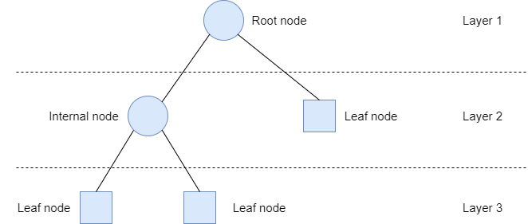
Decision trees - theory
“White-box” model
Weak learner

Slide 6
Random forests - theory
Ensemble of decision trees
Advantages of using Random Forests:
Better generalization on unseen data
High accuracy
Fast training time

Slide 7
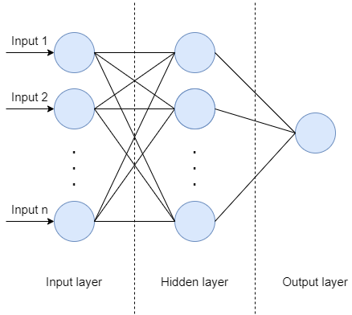
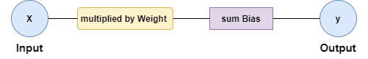
Neural networks - theory
Mathematical models vaguely inspired by biological neural networks
Each node is a set of inputs, weight, and a bias value.
Neurons are grouped by layers
Universal aproximator.

Slide 8
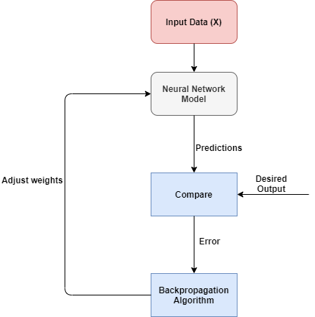
Training neural networks

Slide 9
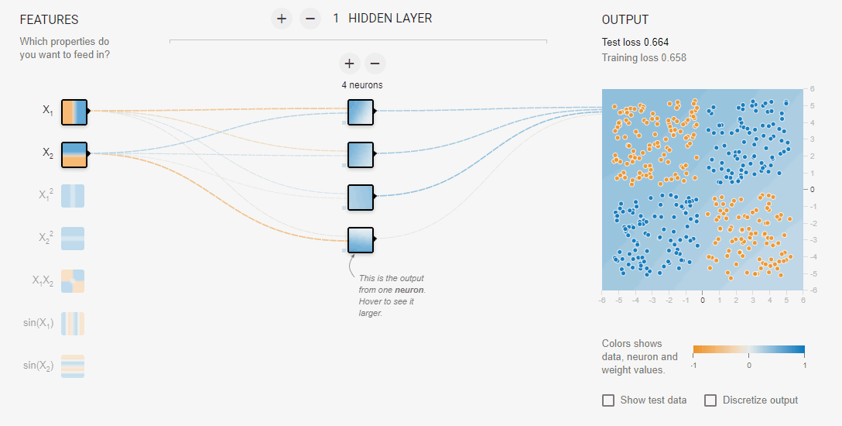
Neural network in action!
Created at: https://playground.tensorflow.org/

Slide 10

SO… more complexity means better neural network performance?
The answer to this question is simple, NO!
Why?

Slide 11
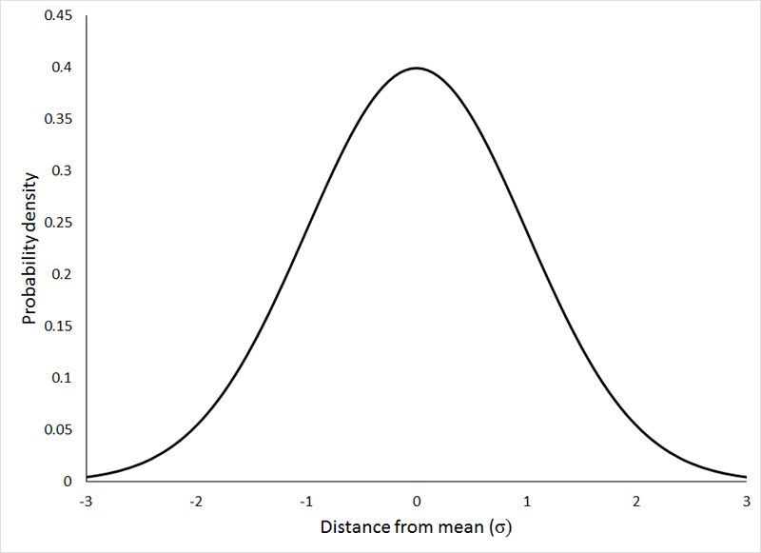
Data preprocessing - theory
Country
Spain
Portugal
Spain | Portugal
1 | 0
0 | 1
Country
0
1
Common procedures:
View dataset
Treat the missing values
Convert categorical features
Feature scaling
Splitting the dataset

Slide 12

Implementation with python
Google Colab
No need to install Python locally
Fast to start experimenting
Can run expensive computacions in cloud
Great for merging code with text (markdown)
Prerequisites:
Academic Dropout Dataset

Slide 13


THE END
Feel free to ask any question!
Scan the following QR code for all the material:

